Slide 1
Mission Statement
Helping to ensure a safe and healthy workplace for every worker in the state of Utah.

Slide 2
OSHSPA Update
OSHA Budget: Increased cost of using the OSHA database is being passed onto the state plan states.
Penalty Increases: OSHA has indicated that they will be pursuing action against state plans that haven’t made “significant steps to adopt.”

Slide 3
Industry | Cause | Description
General | Struck By | Employee was crushed by a floor platform on a workover rig that was in the process of being removed.
Public Sector | Caught In Between | Employee exited a vehicle to close a gate, the driver pulled the vehicle through the gate and found the employee on the ground.
General | Electric Shock | Three maintenance employees were killed when an Industrial truck contacted overhead power transmission lines.
Construction | Fall | Employee fell through a wall opening from the 4th floor to a scaffold on the 2nd floor.
Construction | Caught In Between | Employee was crushed by soil after falling into a trench when it caved-in.
Construction | Electric Shock | Employee was electrocuted after coming in contact with a power line while removing shingles on a roof.
General | Struck By | Still under investigation.
Construction | Fall | Still under investigation.
Fatalities

Slide 4
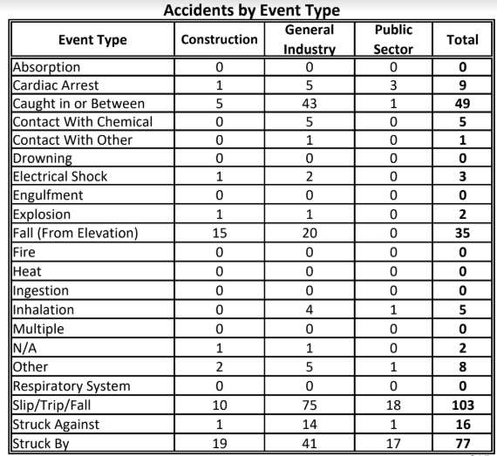
Accidents/Event

Slide 5
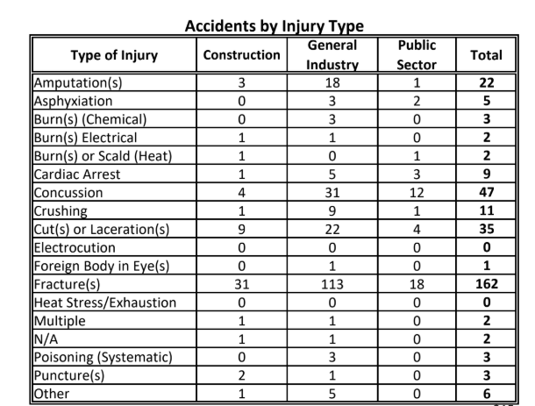
Accidents/Injury

Slide 6
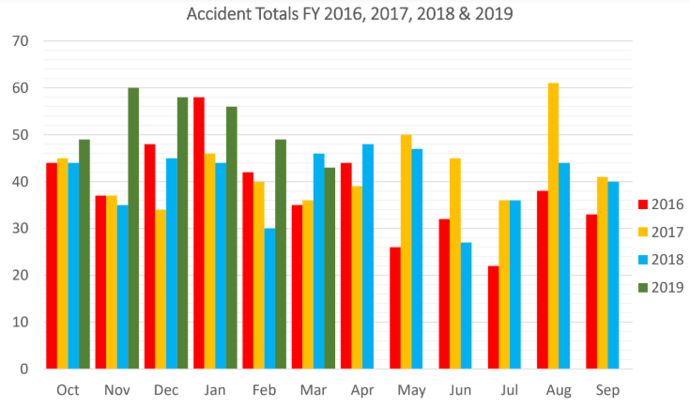
Accidents by Month

Slide 7
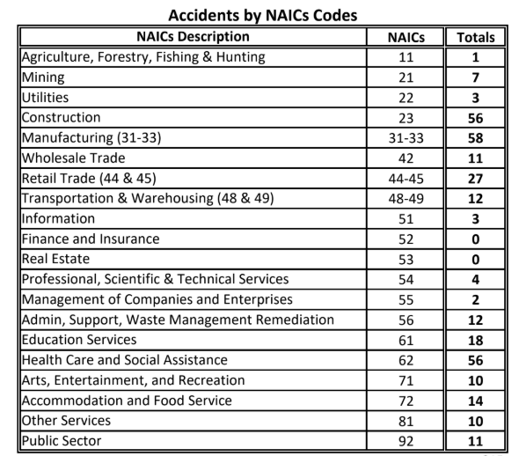
Accidents by NAICS
Compliance

Slide 8
Upcoming Events
OSHSPA Board Meeting: April 11
VPPPA Conference will be hosted in SLC the week of April 23
Stand Down to prevent falls in Construction: May 6-10
Trenching Stand Down: June 17-22
Utah Safety Week: June 17-21
The next Advisory Council meeting will be in July

Slide 9
Public Sector: May 1, 2019 @ 9 am in the UOSH Conference Room
Construction: April 30, 2019 @ 9 am in the UOSH Conference Room
General Industry: April 29, 2019 @ 9 am in the UOSH Conference Room
Industry Work Groups

Slide 10
UOSH Contacts
UOSH Compliance
(801) 530-6900
jsokoloff@Utah.gov
UOSH Bureau of Labor Statistics
hlawrence@Utah.gov
UOSH Consultation
(801) 530 – 6855
consultation-program@Utah.gov
Laborcommission.Utah.gov/divisions/UOSH/index.html

Slide 11
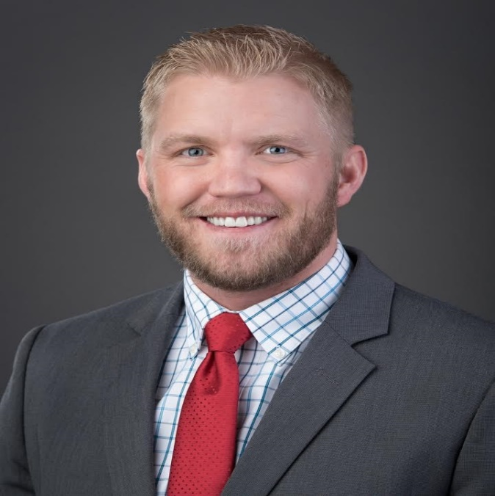
Cameron Ruppe
UOSH Director
cruppe@utah.gov
801-530-6898

