Slide 1
Systems Focused
Incident Investigations
Environment
Optimized
System
Capability
Motivation
Robert K. Gardner, ARM Douglas R. Handy, CSP
Technical Consultant Technical Consultant
Liberty Mutual Insurance Liberty Mutual Insurance
Risk Control Services Risk Control Services
The illustrations, instructions, and principles contained in the material are general in scope and, to the best of our knowledge, current at the time of publication. Our risk control services are advisory only. We assume no responsibility for: managing or controlling customer safety activities, implementing any recommended corrective measures, or identifying all potential hazards. No attempt has been made to interpret any referenced codes, standards, or regulations. Please refer to the appropriate government authority for interpretation or clarification. Insurance is underwritten by Liberty Mutual Insurance Company or its affiliates or subsidiaries.

Slide 2
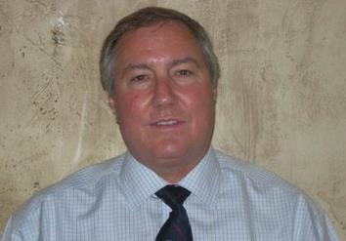
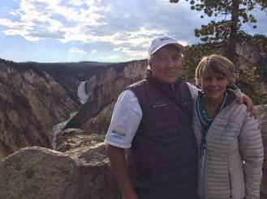
Your Presenters
Rob with wife Gayle. Family of 5 Children &19 Grandchildren.
Over 34 years in Safety Profession (15 as Safety Director, 19 as Insurance Risk Control Consultant)
Robert K. Gardner, ARM
Liberty Mutual Insurance
Risk Control Services
Technical Consultant II
Salt Lake City, Utah
Notes:
Provide a virtual introduction
Add photo (doesn’t have to be formal)
Name
Designations
Title

Slide 3
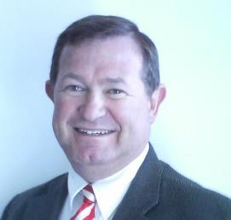

Your Presenters
Doug with wife Minette. Family of 3 Children & 3 Grandchildren.
Over 40 years in Safety Profession (27 as Safety Director, 13 as Insurance Risk Control Consultant)
Douglas R. Handy, CSP
Liberty Mutual Insurance
Risk Control Services-UPS Team
Technical Consultant II
Salt Lake City, Utah
Notes:
Provide a virtual introduction
Add photo (doesn’t have to be formal)
Name
Designations
Title

Slide 4

What are you investigating?

Slide 5
“Safety outweighing every other consideration?”
What’s the reality within your organization?

Slide 6
How Many Squares?
Notes:
Optional ice breaker: Ask attendees how many squares they see. Point out that it’s not a trick question, all are squares and not rectangles. After some answers, proceed to slide 17 and point out that, like accident investigations, all may not be as it seems...it takes some thought to come up with the right answer.

Slide 7
How Many Squares?
1

Slide 8
How Many Squares?
2

Slide 9
How Many Squares?
3

Slide 10
How Many Squares?
4

Slide 11
How Many Squares?
5

Slide 12
How Many Squares?
6

Slide 13
How Many Squares?
7

Slide 14
How Many Squares?
8

Slide 15
How Many Squares?
9

Slide 16
How Many Squares?
10

Slide 17
How Many Squares?
11

Slide 18
How Many Squares?
12

Slide 19
How Many Squares?
13

Slide 20
How Many Squares?
14
14
14
14
14
14
14

Slide 21
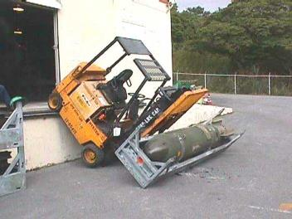
What Is An Accident?
An unforeseen or unplanned event or circumstance
Accidents and injuries are not the same; accidents do not necessarily result in injuries
Accidents are usually caused by a “process failure”, either in planning or methods application

Slide 22
Do All Accidents Need To Be Investigated?
…For Every 330 Unsafe Acts
0.67
1
Lost-time or fatal injury
29
20
Minor injuries
Reduce this by 33%
Best Place for Safety Efforts
300
No injury; unsafe actions or conditions
200

Slide 23
The Investigation
What is the primary goal?
  Identify immediate, basic and root causes
  Eliminate or control causes
Eliminating or controlling causes will prevent similar reoccurrences
  Keeps employees safe, saves time, reduces expenses and maintains proper workflow and operations

Slide 24
Typical Incident Investigations
Are primarily compliance-oriented (use punishment and focus on “Have to Safety”)
Are reactive (when something bad happens, efforts are made to address problems)
Are focused mainly on “At-Risk” behaviors (what is wrong vs validating and encouraging desired performance)
Reinforce the use of punishment because it works in the short-term and has an immediate payoff
Usually become over-reliant on punishment as a strategy for motivation
Notes:
Many safety programs are primarily compliance-oriented and it is not difficult to understand how they might have evolved that way. Most of what people are asked to do for the sake of “safety” is difficult, uncomfortable, or takes time. The reason to do it may be clear, or not, but it is viewed as what must be done. Success is avoidance of something bad such as an incident, injury, or citation. Since, at the individual level, we do not have the perspective that something bad will happen for what we believe to be a productive thing to do, organizations impose additional things to avoid in the hope of motivating the behavior desired. In other words, the programs we write become inherently punishment-based.
Punishment-based programs are reactive, engaged after what is not wanted occurs. One of the many effects this can drive is an ever increasing tendency toward complexity. With each new “bad thing” that is discovered, another set of rules is needed. Eventually, the program becomes immense and increasingly punishing, both from the perspective of the individual that must comply and the organization that must enforce.
A very important part of our learning, development, and evolution is the discovery of what not to do. (Although, this is certainly not more important than the discovery of what to do.) Absent an abnormal mental condition, a person will not engage in a behavior that has unacceptable risk. The problem is that our knowledge of the risk we face is rarely complete and we are constantly presented with irresistible opportunities to try new things. Many of the new things we try are successful and we describe them with terms like innovation, best practice, and progress. Some of the new things produce harm and we call those at risk behaviors. Organizations have no problem identifying these. They are the behaviors that are identified as root or core causes. What complicates the problem for organizations is that many of these “at risk” behaviors, at the individual performer level, are quite productive most of the time.
The reliance on punishment has persisted because “it works” and it works quickly. As we will explore in more detail in a moment, this is a fact. Any behavior that is truly punished will not be repeated.
However, because punishment works so quickly, its immediate payoff often causes people in positions of accountability to become overly dependent on it.
The net result is an over-reliance on punishment as a strategy for motivation productive performance. The paradigm suggested by the old adage: “Lack of punishment is it’s own reward!” will not produce the level of performance sought in the workplace of the 21st century, if it ever did at an earlier time.

Slide 25

1907 Foundry Accident Data – Has anything changed?
Have we really made much progress?

Slide 26
Risk Iceberg
Injuries
Incidents
Company Management &
the Safety Department
Near Misses
Risk
> Conditions
> Behaviors
Those who are closest to the risk:
Employees
Notes:
This is a graphic representation of the Risk Iceberg. The iceberg consists of several main areas:
1. Injuries at the top of the iceberg. These are above the water and are very visible in most companies through reports, postings, discussions, etc.
2. Incidents are directly below the injuries on the iceberg. These are also very visible although it is possible that injuries may have been prevented. This may represent a crash or equipment damage of some sort.
3. Near Misses are also represented in this model. You can see that most of the near misses are under the water and not visible to company management and the safety department. Why is this? It is true that some near misses are visible above the water because they are reported to management and the safety department. In most companies this is the exception to the rule.
4. You will also see RISK that considers both conditions and behaviors represented on the model. This is by far the largest portion of the model. Please consider that this is largely invisible to company management and the safety department.
You will notice a submarine in this graphic representation. It represents the employees that are closest to the risk and who have the best view of workplace RISK. They are literally under the water in this model and can see near misses and risk more clearly. Our experience has taught us that these employees are truly in the best position to make observations and share essential risk information with management and the safety department that will help reduce the risk, enhance the safety process and improve operational effectiveness. This information coupled with the safety knowledge and experience that the company brings to the table helps provide a framework for best practice risk assessments and workplace risk reduction. The benefits of such a strategy include significant risk reductions, safety process improvements, operational effectiveness improvements, enhanced teamwork, Leadership Development and reduction in losses over time. The so called “Law of the Harvest” applies. Companies that sow well reap well. In other words, the more a company puts into this process the more they get out of it.

Slide 27

Systems At Work
Thorough examination
of all three system elements…
Similar to ASSP 3E’s of Safety – Engineering, Education, Enforcement
Leads to reduced risk, better solutions & lower likelihood of reoccurrence…
More sustainable solutions
Environment
Processes
Processes
Optimized
System
Processes
Processes
Capability
Motivation

Slide 28
“System Safety” Defined
An element of system engineering involving the application of scientific and management principles for timely recognition, evaluation and control of hazards within a system.
Notes:
In the arena of system safety, a large number of techniques have been developed and used by the safety professional to evaluate sources of loss and identify causes. It will be helpful to have an understanding of some common terms used in System Safety.
Note to Facilitator – you can use a flip chart to highlight these terms.
• A System is a composite of man, machines, materials and methods that are used to perform a specific task in a specified environment.
• System Safety deals with the optimum degree of safety that can be achieved within the constraints of system effectiveness.
• System Engineering deals with the integration of all system components to achieve maximum overall system effectiveness.
• System Safety Engineering combines both concepts and is defined as an element of system engineering involving the application of scientific and management principles for the timely recognition, evaluation and control of hazards within a system. It is based on the premise that:
Incidents result from a number of interacting causes within a system,
Each Incident cause and interaction can be logically identified and evaluated, and
Solutions can be developed to control each Incident cause.

Slide 29
Systems for Safety & Incident Investigation
Success System Safety (Identification, Evaluation, Communication)
System Analysis techniques
Cause and Effect
Fishbone
Incident Causation Model
We propose: Systems At Work

Slide 30
Systems At Work
Thorough examination
of all three system elements…
Similar to ASSP 3E’s of Safety – Engineering, Education, Enforcement
Leads to reduced risk, better solutions & lower likelihood of reoccurrence…
More sustainable solutions
Environment
Processes
Processes
Optimized
System
Processes
Processes
Capability
Motivation

Slide 31
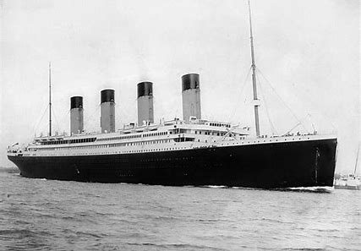
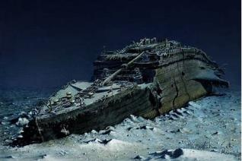
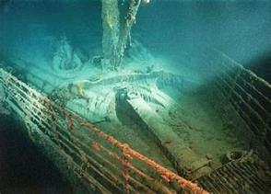
Systems At Work
The Titanic Disaster
Notes:
Facilitator – divide the class into 2 groups or 4 groups. Have a group conduct a fishbone analysis of the Hit other in rear vehicle Incident workshop and have the other group conduct an Incident causation model for the finger amputation workshop. If the class is large, and you use 4 groups you can have each group work on specific elements of the model, for instance:
Fishbone – one group work on vehicle and operator, while the other group works on maintenance and environment
Incident causation – one group work on person and policies, another group work on equipment and environment.
Give the groups about 10 minutes to brainstorm on contributing factors for each incident and 5 minutes per group to report.
*see the facilitator workshop guide for “book” answers and use if needed.

Slide 32
Competing Priorities
“Safety outweighing every other consideration?”

Slide 33
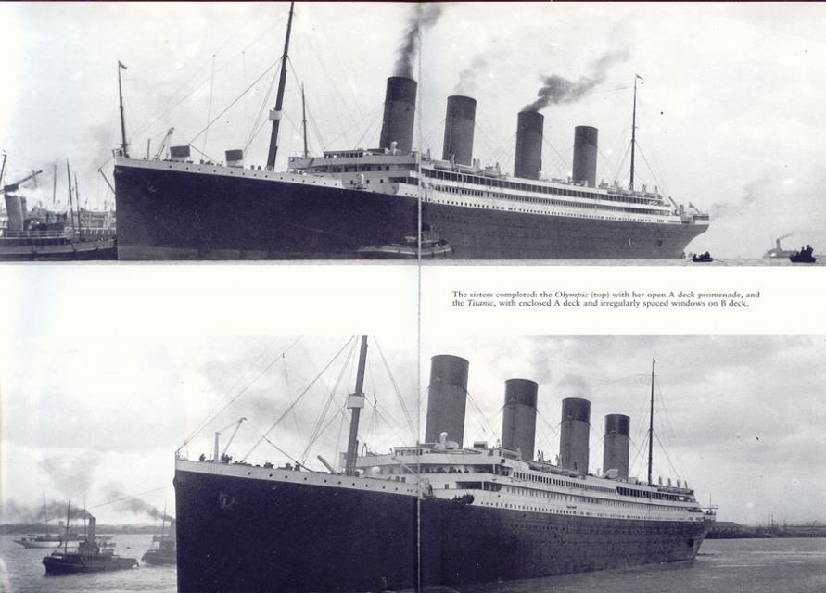
The Olympic: Commissioned
14th June 1911
The Titanic: Commissioned
11th April 1912

Slide 34
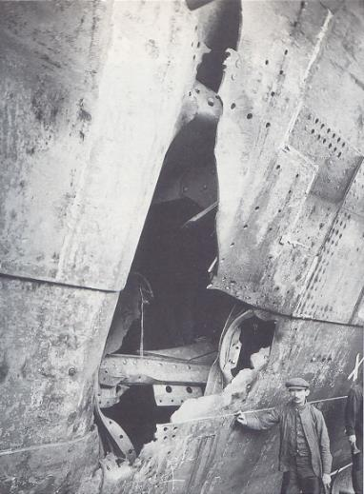
The Olympic – Prelude to Disaster
21st Jun 1911
  Upon commissioning crashed into & almost sunk O.L. Halenbeck in Manhattan
20th Sep 1911
  Crashed into the Naval Cruiser the HMS Hawke in Southampton
24th Feb 1912
  Knocked-off one of its twenty-six tone propellers on a well-known wreck in the Grand Banks
Captained by Edward J. Smith.
Damage to the Olympic from the
HMAS Hawke
impact
Reference: ‘The Riddle of the Titanic’, Gardiner et. al. Orion, 1998

Slide 35
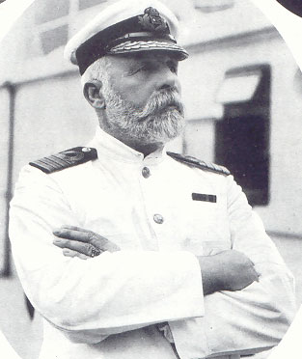
Captain Edward J. Smith
27th Jan 1889
  Ran The Republic aground in New York
1st Dec 1890
  Ran The Coptic aground in Rio de Janerio
4th Nov 1909
  Ran The Adriatic aground outside New York
  History of running ships too fast through narrow passages.. and of not adequately training his officers
Captain Smith
Commissioned to Command the Titanic
Reference: ‘The Riddle of the Titanic’, Gardiner et. al. Orion, 1998

Slide 36
Titanic - Tragic Circumstances
14th April 1912
  Smith received at least six warnings of Ice field from ships at dead stop in the area
  No binoculars in the crow’s nest meant that early warning was near impossible
  Titanic sped toward ice field at 22.5 knots vs a recommended 10 knots in such conditions
Motivations for this speed
  Desire to break the transatlantic speed record as encouraged by J. Bruce Ismay MD of White Star who was on board for the maiden voyage
Safety Response Capability
  Lifeboats on the ship had been reduced from sixty-four boats to twenty-two in lieu of more expansive promenades
  The officers on board The Titanic had not trained with the lifeboats and were unsure of their holding capacity
  There was not a standing safety-response plan.. the ‘Women and Children first’ response was a reaction more than a previously-agreed plan.

Slide 37
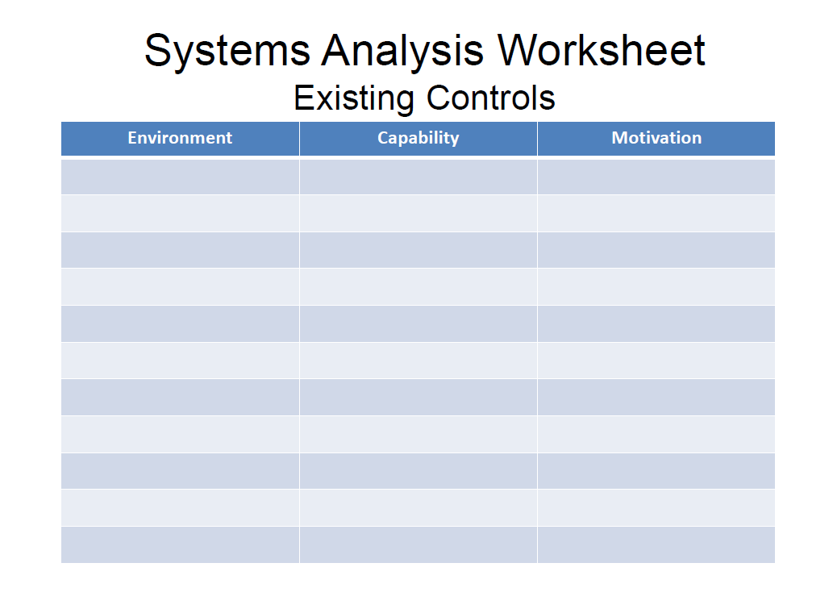

Slide 38
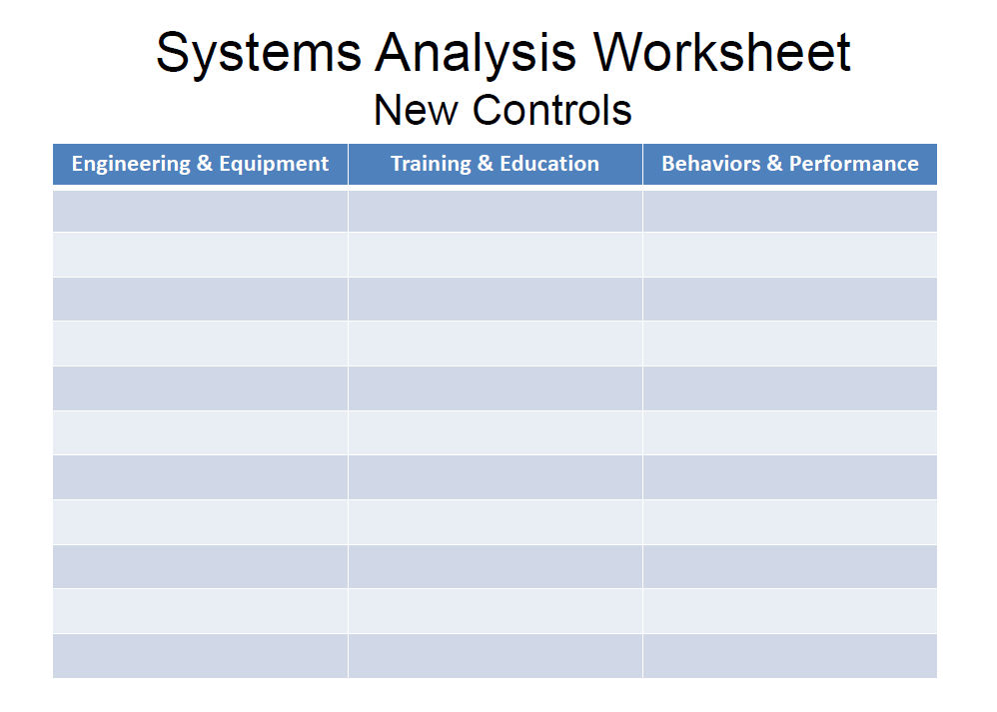

Slide 39
Workshop Review (4 hour course)
Break into 4 teams of 5-8 each
2 teams - #1 & #4
  Work on Investigation of Ship Design to Leaving Port
2 teams - #2 & #3
  Work on Leaving Port and Emergency Response
30 minutes of Workshop
Each team to make a 5-8 minute report-out/presentation on investigations and recommendations

Slide 40
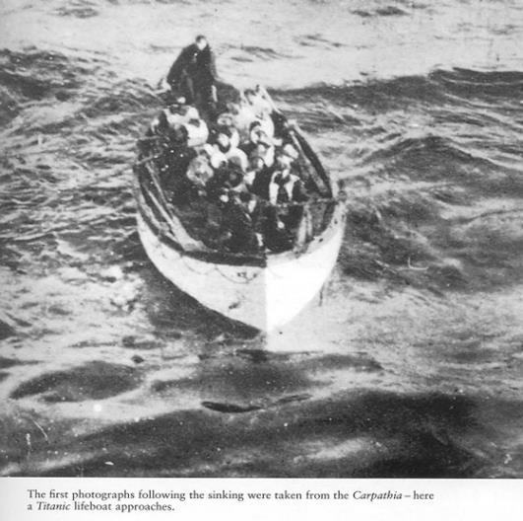
The Results
Lives Saved: 705
Lives Lost: 1500
Total passengers 2,205
Max Lifeboat Capacity 1,600
It wasn’t until 45 minutes after the collision that officers commenced preparing the lifeboats
Twenty lifeboats were launched
Officers feared that the ship’s davits & winches would not hold the weight of the recommended 70 people
All but the last few lifeboats floated were half-filled
It is a fact that had the Officers filled the lifeboats per their specification an additional 600+ people could have been saved.

Slide 41
Changes made from Titanic Incident Investigation
Ship designs – verified standards and materials, Bulkhead compartments raised higher above water lines, water-tight compartment design changes.
Lifeboats and Life jacket changes – enough for all passengers and crew on ships.
Required Muster Drills
Adequate distribution on crew assigned to each Lifeboat, and crew trained on emergency and evacuation procedures.
Radio Act of 1912 – radio operators covering 24 hours a day, training on equipment, message prioritization procedures.
Ice Patrol – Initiated in 1914 – to better identify ice in maritime waters.
Life Insurance & Liability to owners – for value of ship/trip

Slide 42
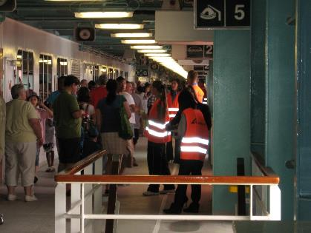
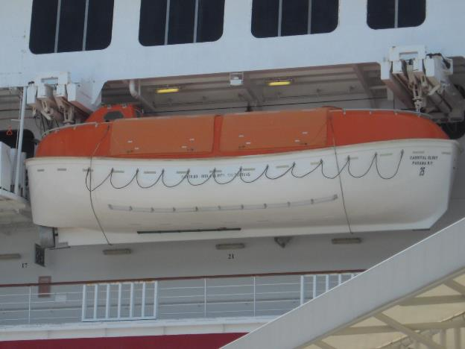
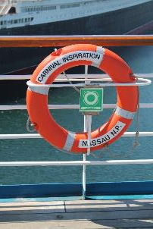
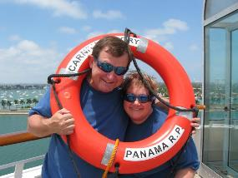
Some of the items resulting from Titanic investigation

Slide 43
“Safety outweighing every other consideration”
This was the framed notice in the
chart room of every White Star ocean liner in 1912!

Slide 44
It took two years to build the Titanic . . .
and 2 hours and 40 minutes to sink it.
https://www.youtube.com/watch?v=FSGeskFzE0s

Slide 45
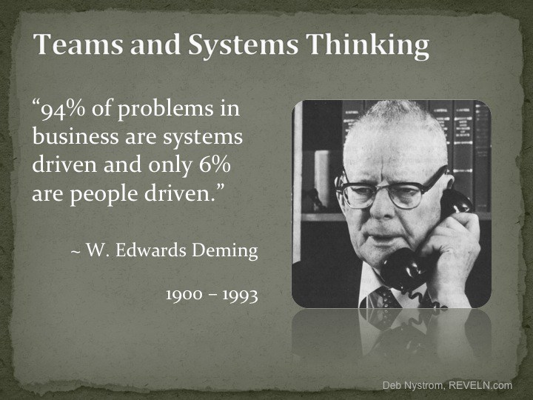
W. Edwards Deming is commonly known for his management and systems teachings that influenced Toyota Motors Quality System.
His work and teachings continue to influence progressive companies around the world.

Slide 46
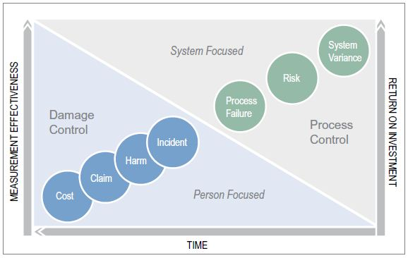
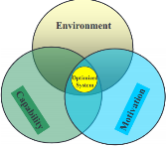
The Loss Cost Stream – Systems Thinking
If efforts are mostly damage control, there is little time to work on process control, reducing risk and improving systems.

Slide 47
System Components of Risk
Environment
  People don’t have the tools & equipment they need to work productively
Capability
  People don’t know or unable to do what should be done
Motivation
  People don’t do what they need to do
Engineering
Training & Skills
Manage Consequences
Notes:
Within these system components, we can define the risk that arises from system discrepancies.
Environmental risk occurs when people do not have the tools and equipment they need to do the job. The solutions are engineering in nature.
Capability risk occurs when peoples ability, in other words, their knowledge, physical ability and task skills do not match the demands of the job to be done. The solutions are about maintaining the workforce’s fitness for duty.
Performance risk occurs when people do not perform as intended. The solutions are about managing consequences or what can be referred to as behavioral safety.
Whether the system is examined from the perspective of environment, capability, or motivation, it is important to remember that each affects, and is affected by the other. Engineering changes most often demand additional education and training. People cannot be motivated to perform if they do not know what to do, how to do it, or why it should be done. The most skilled and motivated people cannot execute optimally without adequate tools.

Slide 48
Systems Thinking for Incident Investigations
What
Happened
What Else Was
Happening
Incident
(describes the
system)
Event/Condition Charting
Identify Causal Factors
Root Cause Analysis - 5 Why Analysis
Environmental
Discrepancies
(Engineering Needs)
Capability
Discrepancies
(Training Needs)
Motivational
Discrepancies
(At Risk Behaviors)
Why?
Why?
Why?
Engineering Assessment
Ergonomics
Safety Engineering
Management Theory
Environment
Training Needs Analysis
Could the associate perform
as expected if his/her life
depended on it?
Performance Gap Analysis
List Antecedents
List Consequences
Classify consequences
List Reinforcing consequences
Rank consequences by strength
Why?
Why?
Why?
Root Cause
Root Cause
Root Cause
Notes:
Again, the next two slides offer a visual model of how we can use an undesirable output of a system... An Injury Incident... To 1st define the limits of the system we are going to be analyzing, 2nd use Event/Condition charting to organize the incident data into the “causal factors” of the incident (there are several slides that discuss Event/Condition Charting later in this presentation .. No need for detailed explanation now) 3rd conduct 5Why analysis of the ID causal factors.... This could also involve conducting more in-depth engineering assessments or training and behavioral analysis to help determine root causes, ..... And on the next slide...4th Integrated Solutions and Action Plans.

Slide 49
Systems Thinking for Incident Investigations
From
Incident Report
What happened? (Undesirable System Output)
What happened – describes the limits of the System
What are the system factors (Inputs)?
Environment
Capability
Motivation
Which of the factors could be contributing to the concern?
What could be done to change them?
To
Countermeasures
Notes:
This slide visually represents the basic steps of an incident analysis that were just reviewed.
.

Slide 50
Systems Thinking for Incident Investigations - Continued
Root Cause
Root Cause
Root Cause
What?
(Countermeasures)
What could remove the root
causes?
Action plan!
What is the most effective
course of action?

Slide 51
“Productive” & “Just” Incident Investigations
Take Incident Investigation out of the “backroom” and into the work area where it belongs
Involve people closest to the incidents to better understand why and to develop new controls to prevent reoccurrence
Instead of blaming employees, focus on system failures and get employee’s “Discretionary Effort” to improve the system
Default Thinking: How did our System Fail You?

Slide 52
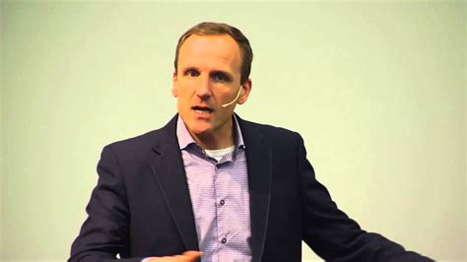
“Underneath every simple, obvious story about ‘human error,’ there is a deeper, more complex story about the organization.”
Sydney Dekker

Slide 53
Environment
Optimized
System
Capability
Motivation
“Safety outweighing every other consideration?”
What’s the reality within your organization?

Slide 54
Thank You!
Robert K. Gardner & Douglas R. Handy
Technical Consultants
Liberty Mutual Insurance
Risk Control Services
Robert.gardner@libertymutual.com
Douglas.handy@libertymutual.com
Our loss prevention service is advisory only. We assume no responsibility for management or control of customer safety activities nor for implementation of recommended corrective measures. This report is based on information supplied by the customer and observations of conditions and practices at the time of the visit. We have not tried to identify all hazards. We do not warrant that requirements of any federal, state, or local law, regulation or ordinance have or have not been met.
Helping People Live Safer, More Secure Lives

Slide 55
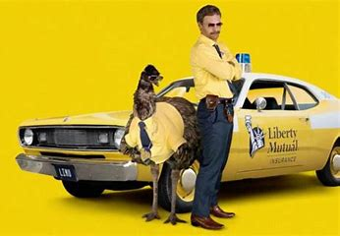
Environment
Optimized
System
Capability
Motivation

